Slide 1
Iterative Improvement

Slide 2
Iterative improvement is a computational technique which has the following steps.
Start with some feasible solution.
Repeat the following step until no improvement is found.
Change the current feasible solution to a feasible solution with a better value of objective function
Return the last feasible solution as the optimal solution

Slide 3
Application of Iterative Improvement
Simplex Method
Ford-Flukersons Maximum flow problem.
Maximum Matching in Bipartite Graph
Stable Marriage Problem

Slide 4
Ford Fulkerson Algorithm for Maximum Flow
Problem: Given a graph which represent a flow network where every edge has a capacity. Also given two vertices source S and sink T in the graph.
Find out the maximum possible flow from S to T with following constraints.
Flow on an edge does not exceed the given capacity of the edge.
Inflow is equal to outflow for every vertex except S and T.

Slide 5
Algorithm
Ford- Fulkerson Algorithm
The following is a simple idea of the algorithm
Start with a initial Flow as zero (0).
While there is an augmenting path from Source to Sink
Add two path flow to flow
3. Return flow

Slide 6
Terminology
Residual Graph: It’s a graph which indicates additional possible flow if there is such path from source to sink then there is a possibility to add the flow.
Residual Capacity: Its original capacity of the edge minus flow.
Minimal Cut: Also known as bottleneck capacity. Which decides maximum possible flow from source to sink through an augmented path.
Augmented Path: Augmenting path can be done in two ways.
1. Non Full forward edges.
2. Non-empty backward edges.

Slide 7
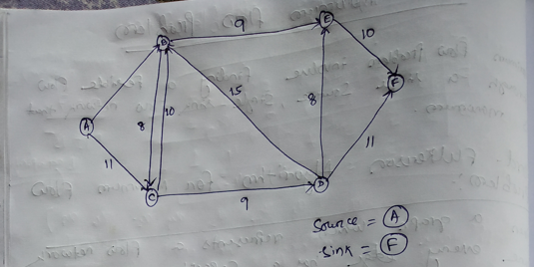
15

Slide 8
Consider a path: A-C-D-F
A
C
D
F
9/11
9/9
9/11
Maximum flow possible through the particular path is 9. Residual capacity of AC is 2, CD is 0 and DF is 2

